Slide 1
Making the switch from desktop to web development
Chad J. Lemmer
Wausau.js meetup August 13, 2019

Slide 2
Background
Started on a Commodore 64 in 2nd Grade
I.T. Manager - Wausau Coated Products (24 years)
Part-time Help Desk while going to NTC
Programmer/Analyst (starting in FoxPro for DOS)
I.T. Manager
Owner - C.J. Software & Consulting, LLC (25 years)
Computer installation, upgrades & repair
Data Backup & Recovery
Custom software development
Website design, development, and hosting (primarily WordPress)
Specialize in Visual FoxPro software development (EOL: 2015)
Continue to support many VFP applications, but it’s time to move on!

Slide 3
VFP vs web
VFP
One tool for everything (database, code, forms, reports, etc…)
Learning curve is not too steep
Compiles into EXE
Web Dev
Many options for database, server, front-end, frameworks
Selecting options requires careful consideration
Longevity – will it still be around tomorrow, next year, and beyond?
Support – both corporate and community support
Developer/Team availability & skill level
Business needs

Slide 4
Web Dev – Fundamentals vs. framework
New developers often ask which they should learn first
Fundamentals
Can be applied to multiple frameworks
When the framework doesn’t work, knowing the fundamentals is critical for debugging
Framework
Faster to get up and running
Feeling more productive and continued motivation (framework stuff can get boring…)

Slide 5
Were to start
Selecting the Language: JavaScript, PHP, Python, Ruby
Tiobe Index
Back-End
Databases, Servers, APIs
Front-End
Building User Interfaces
Full-Stack
Where you “land” will depend on
Personal preference
Business needs
Size/Skillset of team

Slide 6
Back-end frameworks
Node.js
Server-side JavaScript
Express.js
Framework for Node.js
Better handling of requests, responses, and routing
Axios
Makes it easier to handle requests from browser and Node
Returns a data object, whereas fetch() requires passing result to .json() method
XSRF support (Cross Site Forgery)

Slide 7
Databases
MySQL
NoSQL
AWS Aurora or RDS
Google Firestore

Slide 8
Front-end development
HTML
CSS
Bootstrap
Foundation
Tailwind
JavaScript

Slide 9
Front-end Frameworks
Angular
React
Vue
Svelte

Slide 10
OTHER platforms
AWS Amplify
Google Firebase
Suites of tools to accelerate application development
Database
Auth
Hosting
Analytics

Slide 11
Analogy
Selecting your framework(s) is like selecting a pen.
All pens will write, but they all write differently and you may like some pens better than others.
One pen isn’t necessarily better than the other. Different pens are better for different uses.

Slide 12
User experience
UX is not UI
UX is not just wireframes and mock-ups
Usability, accessibility, how users interact with the system (psychological)
Not necessarily reducing the number of clicks/screens, but how easy it is to get where you need to go
Don't make the user think (Doors - push bar vs pull handle)
UX needs to start at the beginning of a project

Slide 13
Hosting Considerations
Digital Ocean, Linode, AWS, Azure
Virtual servers in the cloud
You manage the servers
Heroku
Many books and tutorials use Heroku
Can get expensive for large-scale applications
Netlify
Easy to use
Great integration with GitHub

Slide 14
IDE / Source code control
IDEs
VS Code + Extensions
Keyboard shortcuts: https://code.visualstudio.com/shortcuts/keyboard-shortcuts-windows.pdf
JetBrains
SCC
Git / GitHub
Allows multiple developers to work on the same project
Track and Merge changes
Retains previous code revisions

Slide 15
Debugging
Next to learning the fundamentals of any language or how to use a framework, I think the #1 skill to learn is how to effectively DEBUG applications.
Things are going to go “sideways” at some point….could be in your code, or in the code of a framework, and debugging is essential to getting past those issues.
Resources: Console.log(), Inspect Element, LevelUp Tutorials - Debugging

Slide 16
Technical vs mental challenges
Just figuring out where to start can be downright intimidating.
There are just too many options!!!
Many days spent reading books, articles, and going through tutorials
As a seasoned developer in another language, I’m my own worst enemy
Got stuck in “tutorial mode”.
Sooner or later, you just have to…

Slide 17
Just Build Something

Slide 18
Staying motivated
Tell others what you are doing and share your experiences, good and bad
When you tell others what your are doing, you are more inclined to keep moving because you’re not just accountable to yourself
#100daysofcode on Twitter
Don’t compare yourself to others
101 Tips for Being a Great Programmer
https://dev.to/emmawedekind/101-tips-for-being-a-great-programmer-human-36nl

Slide 19
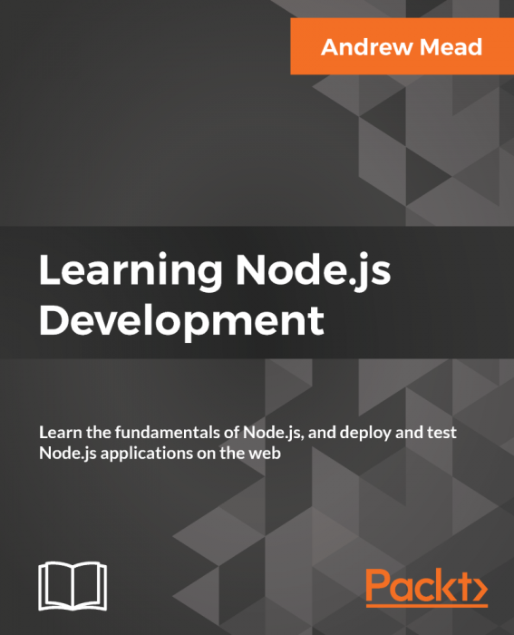
Favorite resources
Favorite Book
Learning Node.js Development
Favorite Online Tutorials
www.wesbos.com
www.leveluptutorials.com
Favorite Podcast
Syntax.fm

Slide 20
Other Resources
https://codepen.io/
https://www.codesandbox.io
https://www.freecodecamp.org/
https://www.codecademy.com/learn/introduction-to-javascript
https://www.jadirectives.com/best-javascript-tutorials-courses-training/
https://developer.mozilla.org
https://www.sitepoint.com/premium/books/javascript-novice-to-ninja

Slide 21
demonstrations
Create React App
Create Vue App
Publish to Github
Host on Netlify
My First Web App

Slide 22
A Simple Web App
Simple app to access a MySQL database and display records in a web browser
Back-End
MySQL
Node.js
Express
Axios
Front-End
HTML (no front-end framework)
Tabulator
Resources
https://www.edureka.co/blog/rest-api-with-node-js/
https://www.edureka.co/blog/node-js-mysql-tutorial/
http://tabulator.info/

